Slide 1
Search in Games (Chapter 5)
Dr. Shengquan Wang
Most slides are adopted from
Artificial Intelligence: A Modern Approach, 4th ed. by Stuart Russell (UC Berkeley) and Peter Norvig (Google).
Peter Norvig and Sebastian Thrun for Intro to Artificial Intelligence at Udacity.
Dan Klein and Pieter Abbeel for CS188 Intro to AI at UC Berkeley.

Slide 2

Tic-Tac-Toe
It is a paper-and-pencil game for two players, X and O, who take turns marking the spaces in a 3×3 grid.
The player who succeeds in placing three of their marks in a horizontal, vertical, or diagonal row wins the game.
https://en.wikipedia.org/wiki/Tic-tac-toe

Slide 3
Play Tic-Tac-Toe and Gomoku
Tic-Tac-Toe: https://playtictactoe.org
Gomoku: https://gomokuonline.com

Slide 4
Outline
Introduction

Slide 5
Games
It is a multiagent competitive environment , where the agents’ goals are in conflict.
Each agent’s action is contingent on the other agent’s previous action.

Slide 6

Two-Player Games
Environment
Agent A
A’s move
A’s move
Agent B
B’s move
B’s move

Slide 7
Types of Games
 | Deterministic | Stochastic
Fully Observable | chess checkers go | backgammon monopoly
Partially Observable | blind tic-tac-toe | bridge poker scrabble
Our initial focus:
Deterministic
Fully observable
Turn-taking
Two-player
Zero-Sum
Notes:
Rock paper scissors = fully observable, and stochastic.
Tic-tac-toe = fully observable, and deterministic.
Partially observable and stochastic = the most difficult to build and AI agent.

Slide 8
How to Win?
It is an adversarial search problem.
The search tree is called game tree.
Notes:
Search trees often grow exponentially.

Slide 9
Outline
Introduction
Game Tree

Slide 10
Game Tree
A search tree
The nodes are game states.
The edges are moves.

Slide 11
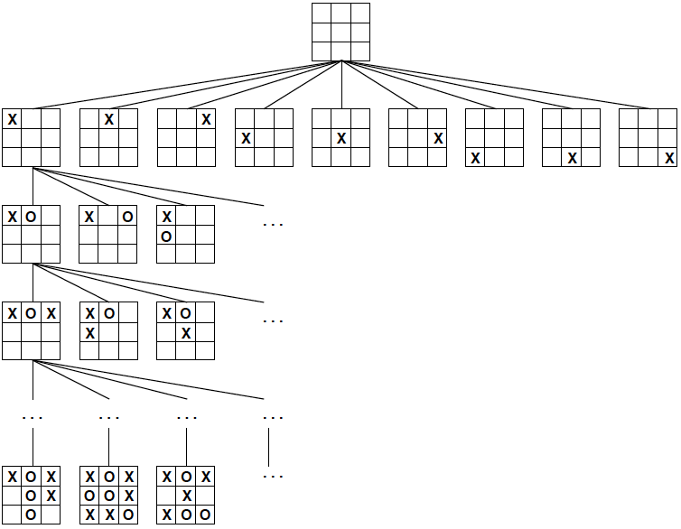
A Partial Game Tree for Tic-Tac-Toe
fewer than 9! = 362,880 terminal nodes
Notes:
Worst case depth = 9 (since 9 possible values).
Number of terminal nodes at greatest terminal depth = just under 9! Nodes.
We need to assign cost/benefit values based on terminal nodes, which need to propagate (recursively) up the tree for assigning parent nodes, since the lower (and/or terminal) nodes determine the ultimate value of all nodes in higher levels (parents).
Since this game is deterministic, we know that we can certainly (or very certainly) determine (non-probabilistic) an absolute best move to make at each step in the game.

Slide 12
Quiz: Strategy for Winning a Game
Uncertainties: we don’t know the future moves of our opponent.
Notes:
So we build a tree with all the possibilities…and assume opponent will choose the best move always.

Slide 13
Optimal Strategy
We need to consider the worst-case scenario: our opponent always picks the best move.
We don’t take a chance.

Slide 14
Outline
Introduction
Game Tree
Optimal Strategy: Minimax

Slide 15
Optimal Strategy: Minimax
Minimax: for each move, minimize the maximum gain among all our opponent’s potential moves.

Slide 16
Optimal Strategy: Two Questions
How to define gain values for two sides?
How to obtain gain values for non-terminal nodes?
Notes:
There is some relativity because gain values depend on which perspective of which opponent.

Slide 17
How to define gain values for two sides?
We can define gain as utility from the perspective of one side, e.g., from the perspective of X in Tic-Tac-Toe
If X wins, X’s utility is +1 and O’s utility is -1
If X loses, X’s utility is -1 and O’s utility is +1
X aims to maximize its utility: MAX(X) O aims to minimize its utility: MIN(O)

Slide 18
How to obtain gain values for non-terminal nodes?
Perform recursion upon the game tree until the terminal nodes.
We call the gain value at each node as Minimax value.

Slide 19
Minimax Value for a Node n (from X perspective)
If n is a Terminal node:
Utility(n)
If n is a Max node:
MaxValue(n) -- Max of n’s successors’ values
If n is a Min node:
MinValue(n) -- Min of n’s successors’ values

Slide 20
Minimax Algorithm
It uses DFS with a simple recursive computation of the minimax values of each successor state.
It proceeds all the way down to the leaves of the tree, and then the minimax values are backed up through the tree.
It keeps track of the minimax decisions from the current state through the recursion.
Notes:
Notice with DFS: as we build the tree, we can assign utility values for any terminal nodes, and each time we move down a level, we allow new information to propagate up the tree to parents where eventually all their children will either terminate or lead to some set of terminal nodes that will combine to form the utility of their parent nodes.

Slide 21
Example: Tic-Tac-Toe (using utility values from X perspective )
X
O | O | X
 | X
O | X
0
O
O | O | X
 | X | X
O | X
O | O | X
 | X
O | X | X
O | O | X
X | X
O | X
-1
-1
0
X
O | O | X
O | X | X
O | X
O | O | X
 | X | X
O | X | O
O | O | X
O | X
O | X | X
O | O | X
 | X | O
O | X | X
O | O | X
X | X | O
O | X
O | O | X
X | X
O | X | O
-1
1
-1
0
0
1
O | O | X
X | X | X
O | X | O
O | O | X
X | X | O
O | X | X
O | O | X
X | X | O
O | X | X
O | O | X
X | X | X
O | X | O
1
0
0
1
Right child is added to frontier first;
Left child returns values and/or is expanded first.
Notes:
Notice since this is from X perspective, then when it is O’s turn, O will choose the min value
And X will choose the max value when it is X’s turn.
Notice at Root, it is X’s turn, it has to choose between 3 node’s utility values: -1, -1, and 0; thus it will choose the max = 0 (the right-most node).
Notice, tic-tac-toe (if played from the start) is a zero-sum game, since if both opponents always play the best option, no one will win/gain (net gain for either opponent = 0); thus total utility for entire game when all moves are optimal sums to 0.
Note from the above example: expansion order is right to left, and selecting next node to expand is LIFO.
Eventually, through recursion, if you build tree out to the final/terminal nodes for all paths, then all nodes will be assigned a utility value all the way up to the root.

Slide 22
Quiz: Tic-Tac-Toe
X
X | X | O
O | O
X
?
O
X

Slide 23
Quiz: Solution
X
X | X | O
O | O
X
0
O
X | X | O
O | O | X
X
X | X | O
O | O
X | X
X | X | O
O | O
X |  | X
0
-1
-1
X
X | X | O
O | O | X
X | O
X | X | O
O | O | X
X |  | O
X | X | O
O | O | O
X | X
X | X | O
O | O
X | X | O
X | X | O
O | O | O
X |  | X
X | X | O
O | O
X | O | X
0
0
-1
0
-1
0
X | X | O
O | O | X
X | O | X
X | X | O
O | O | X
X | X | O
X | X | O
O | O | X
X | X | O
X | X | O
O | O | X
X | O | X
0
0
0
0
Notes:
Notice, if right-most node for O’s first turn, if we find its utility value to be 0, then for the next utility for O, when we determine that one of the utility values is -1, we can prune the tree and know that O will at least select utility of -1, and we know that the max value that the root can choose at that point is 0 (we can use a currentMAX or currentMIN value for every node if we programmed this), so since we find a value where O chooses at least -1, we can ignore finding the actual utility for that O node (at least -1 is good enough to know that X won’t choose -1 or less over the known current options, namely one option in the case I describe of 0). This can be applied as you build the tree with DFS, with Right-to-left expansion order and LIFO for choosing next node to expand to prune the tree and speed up search for optimal solution/strategy.

Slide 24
Example: 2-ply Game
Max
2
1 move with 2 half-moves (2 plies)
Min
-8
-4
2
Max
3
12
-8
2
-4
6
14
5
2
Right child is added to frontier first;
Left child returns values and/or is expanded first.
Notes:
Right-to-left addition of children, LIFO in choosing node to expand next.

Slide 25
Quiz
Max
?
Min
?
?
?
Max
-9
-7
2
6
-3
-8
4
7
5
Right child is added to frontier first;
Left child returns values and/or is expanded first.

Slide 26
Quiz: Solution
Max
4
Min
-9
-8
4
Max
-9
-7
2
6
-3
-8
4
7
5
Right child is added to frontier first;
Left child returns values and/or is expanded first.

Slide 27
Utility Vector
For more than two players, we use utility vector instead of single minimax value.
We can convert minimax value into utility vector.

Slide 28
Example: Utility Vector (A,B) for Two Players
A
(4,-4)
B
(-9,9)
(-8,8)
(4,-4)
(-9,9)
(-7,7)
(2,-2)
(6,-6)
(-3,3)
(-8,8)
(4,-4)
(7,-7)
(5,-5)
Notes:
With utility value, you ALWAYS MAXMIZE because it is based on the player (vector entry) that is playing the next turn; and we always make the perspective of the current players turn as positive.

Slide 29
Example: Utility Vector (A,B,C) for Three Players
A
B
C
(1, 2, 6)
(1, 2, 6)
(1, 5, 2)
(1, 2, 6)
(6, 1, 2)
(1, 5, 2)
(5, 4, 5)
(1, 2, 6)
(4, 2, 3)
(6, 1, 2)
(7, 4, 1)
(5, 1, 1)
(1, 5, 2)
(7, 7, 1)
(5, 4, 5)
Every player aims to maximize its own utility.
For tie-break, it can choose randomly or with an extra criteria.
Notes:
Tie breaker example: instead of choosing 1,2,6 for A, we could choose 1,5,2 since 5+2 =7 is < 6+2 = 8 → criteria is to minimize SUM of all gains of all your opponents.

Slide 30
Minimax Properties
Complete | Yes, if tree is finite (chess has specific rules for this)
Time | O(b^{m}) For chess, b=35, m=100 for “reasonable” games. exact solution completely infeasible. But do we need to explore every path?
Space | O(bm), DFS
Optimal | Yes, against an optimal opponent.

Slide 31
Issue: Scale
Chess:
Average branching factor of about 35.
Games often go to 50 moves by each player.
Game tree for chess:
About 35¹⁰⁰ or 10¹⁵⁴ nodes.
Too expensive to use.
Notes:
Solution to scale being too large: pruning.

Slide 32
Quiz
How to reduce the time complexity O(b^{m})?
Cutting branch
Reducing depth

Slide 33
Outline
Introduction
Game Tree
Optimal Strategy: Minimax
Pruning
Cutting branch
Notes:
Side note: Explore set from search with CSPs (constraint satisfaction problems) is a form of pruning.

Slide 34
Example: 2-ply Game
3
Max
≥3
X
Min
3
≤2
2
X
X
3
12
8
2
14
5
2
Right child is added to frontier first;
Left child returns values and/or is expanded first.
Notes:
This is the pruning related to my notes from a few slides ago when I noticed how you could prune.
Notice: since current max is 3 for MAX node, then once we see 2 for MIN node, which will choose the min, then we know it will choose 2 or less, thus no need to continue to search/expand and find future utilities or explore that path since current max of 3 > (<=2).
So notice you need to keep a variable for current min and max values so we can prune.

Slide 35
α-β Pruning (variable for tracking current MAX)
Define α as the best value (to Max) found so far off the current path.
If v is smaller than α, Max will avoid it => prune that branch.
Max
Min
α
X
v
X
Notes:
Use information gained so far (current MAX, or current MIN for B-a pruning).

Slide 36
α-β Pruning (cont’d)
Similarly, define β as the best value (to Min) found so far off the current path.
If w is greater than β, Min will avoid it => prune that branch.
Min
β
Max
X
w
X

Slide 37
Quiz: Pruning
Max
Min
3
12
8
2
7
9
1
5
14
Right child is added to frontier first;
Left child returns values and/or is expanded first.
Notes:
Order of expansion matters; so if you expand in some order, it may not allow you to prune, where as if you would have expanded in reverse of that order, you may have been able to prune a lot (but there is (generally) no way to know exactly which way to expand).

Slide 38
Quiz: Solution
Max
3
X
X
Min
3
≤2
≤1
X
X
X
X
3
12
8
2
7
9
1
5
14
Right child is added to frontier first;
Left child returns values and/or is expanded first.

Slide 39
Quiz: Pruning
Max
Min
4
5
6
3
8
Max
3
4
7
9
Right child is added to frontier first;
Left child returns values and/or is expanded first.
Notes:
Alpha beta and beta alpha pruning can be done for the case above.

Slide 40
Quiz: Solution
4
Max
X
X
≤3
4
≤4
Min
4
X
X
4
5
6
3
8
X
X
3
4
7
9
Right child is added to frontier first;
Left child returns values and/or is expanded first.

Slide 41
Properties of α-β Pruning
Pruning does not affect final result (it is still accurate at finding optimal solution).
Good move ordering improves effectiveness of pruning.
With “perfect ordering,”
Time complexity = O(b^{m/2})
Doubles solvable depth
Unfortunately, 35^{100/2} for chess is still impossible!

Slide 42
Outline
Introduction
Game Tree
Optimal Strategy: Minimax
Pruning
Cutting branch (still involves cutting some depths)
Reducing depth (for every branch)

Slide 43
Cutoff with Evaluation Function
Use Cutoff-Test instead of Terminal-Test
e.g., depth limit does not allow you to find terminal nodes all the time; may need to settle from some certain depth and consider/treat it like it as a terminal node and assign its utility based on Evaluation function.
Use Eval instead of Utility
i.e., evaluation function that estimates desirability of position.
Notes:
For evaluation function we can make prediction using machine learning to determine the evaluation function (using prediction function from collecting data by running trials).

Slide 44
Eval: Evaluation Function
The evaluation function should be strongly correlated with the actual chances of winning.
The computation must not take too long.
Most evaluation functions work by calculating various features of the state.

Slide 45
Features
The features define various categories of states.
E.g., in chess, features: the number of white pawns, black pawns, white queens, black queens, and so on.
Evaluation function is a function of features.
E.g., in chess: Linear weighted sum of features.
Eval(s) = w₁f₁(s) + w₂f₂(s) + …+ w_{n}f_{n}(s) w₁ = 9 f₁(s) = (number of white queens) - (number of black queens)
Notes:
Notice above, it looks like what we did near end of semester when I first took the course; where we talked about approximation functions and using Bayes Theorem and probability.

Slide 46
Example
Suppose our experience suggests that of the states encountered in the two-pawns vs. one-pawn category
72% lead to a win (utility=+1)
20% to a loss (0)
8% to a draw (1/2)
Then a reasonable evaluation for states in the category is the expected value:
(0.72 × (+1)) + (0.20 × 0) + (0.08 × (1/2)) = 0.76.
Notes:
Use data to feed the curve of the evaluation function.

Slide 47
Cutoff-Test: a Simple Approach
Set a fixed depth limit so that it returns true for all depth greater than some fixed depth d.
The depth d is chosen so that a move is selected within the allocated time.
It can lead to errors due to the approximation.
Notes:
Notice time limit: Chess AI AlphaGo agent can beat the best humans at chess with each player getting 3 hours total move time; but what if there was only 2hrs per player, or 1hr total per player?
Then AI will have less time to make calculations, and thus its calculations for the best move will become less and less accurate/useful; perhaps human can perform better when there is more time pressure; for sure computers/AI can perform at their best the more time there is (probably an exponentially better performance as time increases; and thus 1/a^x performance as time decreases.).

Slide 48
Cutoff-Test: Quiescence Search Approach
The evaluation function should be applied only to positions that are unlikely to exhibit wild swings in value in the near future.
In chess, for example, positions in which favorable captures can be made are not quiescent for an evaluation function that just counts material.
Quiescence search: Non-quiescent positions can be expanded further until quiescent positions are reached.

Slide 49
Forward Pruning
Some moves at a given node are pruned immediately without further consideration.
Clearly, most humans playing chess consider only a few moves from each position (at least consciously).
Beam search:
On each ply, consider only a “beam” of the n best moves (according to the evaluation function) rather than considering all possible moves.
PprobCut:
It uses statistics gained from prior experience to lessen the chance that the best move will be pruned.

Slide 50
Lookup
Many game-playing programs use table lookup rather than search for the opening and ending of games.
For the openings, the computer is mostly relying on the expertise of humans.
Usually after ten moves we end up in a rarely seen position, and the program must switch from table lookup to search.
Near the end of the game there are again fewer possible positions, and thus more chance to do lookup.

Slide 51
Outline
Introduction
Game Tree
Optimal Strategy: Minimax
Pruning
Cutting branch
Reducing depth
Monte Carlo tree search

Slide 52
Monte Carlo Tree Search
It doesn’t use heuristic evaluation function.
Instead, the value of a state is estimated as the average utility over a number of simulations of complete games starting from the state.
Notes:
This is a probabilistic pruning approach – requires machine learning (teaching the machine with more and more data).

Slide 53
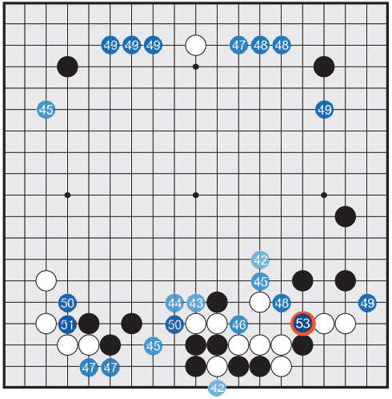
AlphaGo
Black to play:
Percentage of winning if playing at some potential spots.
D Silver et al. Nature 529, 484–489 (2016) doi:10.1038/nature16961
Notes:
This Go game has a larger game tree than even chess!
There is a movie about this game.

Slide 54
Outline
Introduction
Game Tree
Optimal Strategy: Minimax
Pruning
Stochastic Games

Slide 55
Stochastic Games
Many games mirror this unpredictability by including a random element, such as the throwing of dice.
Notes:
Remember with stochastic games: they take on a form of determinism as we learn/gather more data and they converge to some nearly deterministic ratio of options/values/outputs.
The universe is all essentially deterministic; it is just stochastic because of our limited knowledge (like rolling dice, there is some hidden information about how a dice rolls; if we could determine what causes the motion of rolling a dice – say the extremely in-depth physics behind edges of the dice and gravity and friction, we could predict exactly the next output of rolling any dice at any given roll – but obviously as humans, even our computational power we have honed through computers is not enough to predict so as to determine exactly what the roll of a dice will be).
This is manifest in irrational numbers; it is not that pi or Euler's number is “irrational” so much as we humans are limited (the knowledge is hidden from us) about the determined terminal point of the special number and how it fully works.
If we were like God, having all knowledge, then we absolutely could determine the output of every action – and even knowing all possible deterministic outcomes in the universe.
Think about it: God knows exactly what we are thinking; he knows exactly what our brain will do, the exact motion of our arm, air friction, friction of the surface, gravity and all other “forces” as we know them; he even knows about other, hidden forces/laws He wrote into creation, all the way up to the exact angle at which the dice will hit the surface and exactly when forces reach equilibrium according to His Creation laws, and thus exactly the result the dice will land on. Incredible is not even the word to describe the awesomeness and the extensive power and all knowing of God.

Slide 56
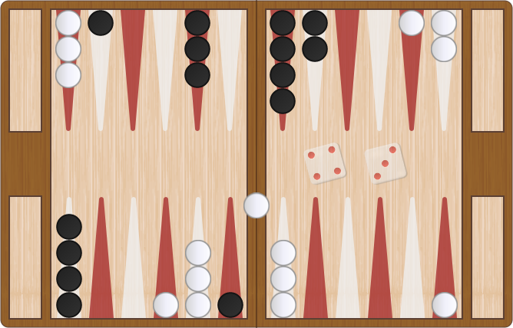
Backgammon
https://cardgames.io/backgammon

Slide 57
Play Backgammon
https://cardgames.io/backgammon

Slide 58
Game Tree with Chance Node
Chance
1/36
{1,1}
1/36
{6,6}
Expected Value
1/18
{1,2}
Max
…
Max Value
1/36
{1,1}
Chance
Expected Value
…
1/36
{6,6}
1/18
{1,2}
Min
…
Min Value
Notes:
to find utilities of decision nodes as you build the tree: use expected values by using probabilities from chance nodes.

Slide 59
Backgammon In Practice
Complexity:
Number of rolls n: 21 possible rolls with 2 dice.
Branching factor b: about 20 legal moves.
Even for a small depth m=4, the complexity is O((bn)^{m}) = O((21*20)⁴) ≈ 3.1*10¹⁰.
TDGammon: world-champion level
Use depth-2 search + very good Eval.

Slide 60
Game Tree for Coin Flipping
?
H: 50%
T: 50%
H
T
?
?
?
?
?
?
H
T
H
T
H
T
H
T
?
7
8
?
0
6
?
4
1
3
2
4
0
10

Slide 61
Solution
4
H: 50%
T: 50%
H
T
5
3
4
5
3
2
H
T
H
T
H
T
H
T
1
7
8
2
0
6
0
4
1
3
2
4
0
10

Slide 62
Quiz
?
H: 50%
T: 50%
H
T
?
?
?
?
?
?
H
T
H
T
H
T
H
T
?
4
2
?
8
0
?
12
6
7
4
5
0
6

Slide 63
Quiz: Solution
5.5
H: 50%
T: 50%
H
T
5
6
5
3
4
6
H
T
H
T
H
T
H
T
6
4
2
4
8
0
0
12
6
7
4
5
0
6

Slide 64
Outline
Introduction
Game Tree
Optimal Strategy: Minimax
Pruning
Stochastic Games
Partially Observable Games

Slide 65
Partially Observability
In the “fog of war,” the existence and disposition of enemy units is often unknown until revealed by direct contact.
As a result, warfare includes the use of scouts and spies to gather information and the use of concealment and bluff to confuse the enemy.
Partially observable games share these characteristics and are thus qualitatively different from the games described before.
Notes:
Notice with Texas Holde Em game: every time new information is gained (more cards revealed), you can update probabilities (BAYES THEOREM) for utility of all your current options.

Slide 66
Card Games
In card games, opponent's initial cards are unknown.
We can calculate a probability for each possible deal.
Just like having one big dice roll.
Idea:
Compute the minimax value of each action in each deal and then choose the action with highest expected value over all deals.

Slide 67
Play Texas Holdem
https://www.table-games-online.com/ultimate-texas-holdem

